Slide 1
Twitter Integration App
By Alex Benchea
Information Type: Working Standard, Disclosure Range: , Information Owner: alexandru.benchea, NTT DATA Romania

Slide 2
Scopul creării aplicatiei
Utilizarea noilor tehnologii (.net core si twitter api)
Developmentul de la 0 al unei aplicatii web
Information Type: Working Standard, Disclosure Range: , Information Owner: alexandru.benchea, NTT DATA Romania

Slide 3
Tehnologii folosite pentru dezvoltarea aplicatiei
Visual studio 2019 (community edition):
→.net Core 3.0
→TweetSharp library
Angular 8
Information Type: Working Standard, Disclosure Range: , Information Owner: alexandru.benchea, NTT DATA Romania

Slide 4
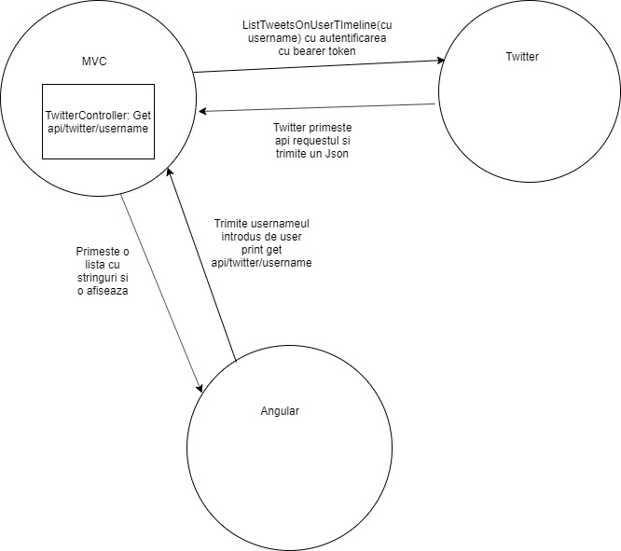
Cum functioneaza aplicatia
Information Type: Working Standard, Disclosure Range: , Information Owner: alexandru.benchea, NTT DATA Romania

Slide 5
Self hosting
In process hosting
IIS
Information Type: Working Standard, Disclosure Range: , Information Owner: alexandru.benchea, NTT DATA Romania

Slide 6
Dece am ales Twitter?
Platforma de socializare preferata
Information Type: Working Standard, Disclosure Range: , Information Owner: alexandru.benchea, NTT DATA Romania

Slide 7
Posibile dezvoltari ulterioare
Folosirea serviciului oferit de libraria TweetSharp pentru a oferii mai multe functionalitati (postarea de Tweet-uri,trimisul de mesaje directe intre user,serviciul de add twitter friend, etc)
Hostarea aplicatiei out of process (eventual pe azure)
Information Type: Working Standard, Disclosure Range: , Information Owner: alexandru.benchea, NTT DATA Romania

Slide 8
Multumesc pentru atentie ☺
Information Type: Working Standard, Disclosure Range: , Information Owner: alexandru.benchea, NTT DATA Romania

